Slide 1



UMYC
Unidad de Mujeres y Ciencia
WOMEN OF SCIENCE, WOMEN IN THE SCIENCES,
SCIENCE WITH WOMEN
Conferencia Interdisciplinar de Estudios de Género - Lisboa
Capitolina Díaz
cdiaz@uniovi.es

Slide 2
I. WOMEN OF SCIENCE
Women working in research, scientific discovery andunderstanding, arts, humanities, technology—knowledge in the broadest sense.
Women who work to further human understanding, systematically and rigorously.
There have always been women of science.

Slide 3
Women of all kinds of science:
Natural sciences
Philosophy and political science
Technology
Computer science
Arts
…..

Slide 4



Slide 5
HYPATIA of ALEXANDRIA (370-415)
A real scientist.
Her interests covered mathematics, mechanics and astronomy, as well as politics and administration. She wrote 44 books.
Technologist: She designed the plane astrolabe, invented a device for distilling water, a graduated hydrometer for measuring the density of liquids and a mechanism for measuring water level.

Slide 6
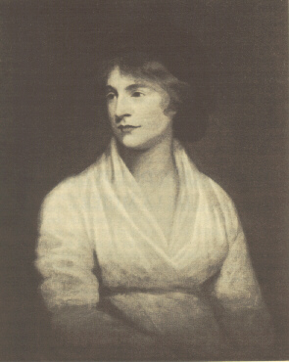
WOMEN AND THOUGHT
Mary Wollstonecraft

Slide 7
Mary Wollstonecraft (1759-1797)
A Vindication of the Rights of Woman(1792):
The state should institute a national system of free, universal primary education for both sexes.
Women, with the right education, “might have practised as physicians, regulated a farm, managed a shop, and stood erect, supported by their own industry...

Slide 8
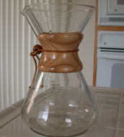
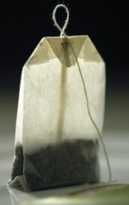
WOMEN AND TECHNOLOGY
Melitta Benz (1873-1950)

Slide 9
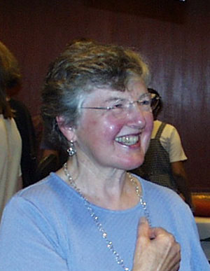
WOMEN IN TECHNOLOGY
Fran Allen

Slide 10
Fran Allen
1st woman to win the Turing Prize (2007)
First female IBM Fellow (1989)
Board of Advisors, “Institute for Women and Technology”.
Created software
    to forecast the weather
    to optimise computer languages’ use of hardware
    to speed up computers with multiple parallel processors.

Slide 11
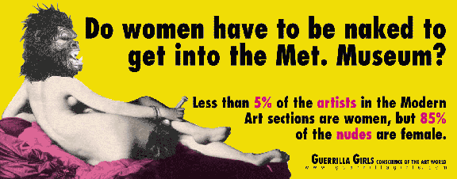
WOMEN AND THE ARTS
Copyright © 1989, 1995 by Guerrilla Girls, Basado en la famosa Odalisca de Ingres
Copyright © 1989, 1995 by Guerrilla Girls, based on Ingres’ famous Odalisque.

Slide 12
II. WOMEN IN SCIENCE
How are women portrayed in the sciences?
Women are practically invisible.
Women are excessively sexualised.
Men are the norm.
Outdated cognitive frameworks
(re)produce discrimination and perpetuate male dominance through highly masculinised content.

Slide 13
White, middle-aged male = norm

Slide 14
Women’s Hearts
Cardiovascular disease is the biggest cause of death for both men and women.
Most research involves only men.
Risk factors for women remain poorly understood.
Women are diagnosed less effectively than men.
Women are given treatments that are cheaper and older (Agnes Wood, 2006).

Slide 15
Man = norm, Woman = sexed being

Slide 16
Publically financed research should NOT accept:
That men are the norm.
Pseudo-scientific arguments for inequalities between men and women.
Samples that do not include both sexes (if dealing with a phenomenon that affects both, as in the vast majority of cases).
Projects that do not include analysis of gender impact.

Slide 17
III. SCIENCE with WOMEN
Research must include women and men, their experiences and their needs.
It must NEVER be assumed that men and women react in the same way NOR in a different way.
Research must not (re)produce sexual, racial or class stereotypes .
Science that is not obsessed with sex, but that is aware of gender... Gender relations, gender in society, gendered norms...

Slide 18
DEGENDERING SCIENCE =
ELIMINATING SEXIST BIAS
Process of reassessment so that the sciences recruit progressively and proportionately more women—and more men—with the critical vision needed to reduce the current gender bias
Critical review of the received paradigms
Reality produces science and science shapes reality

Slide 19
De/gendered Science Feminiscience
≠
Gender is not a fundamental internal state but a performative act, repeated daily.
To eradicate gender bias in science, we must continually carry out the performative act of degendering science and of producing degendered science.
This is not feminiscience: women are too diverse in their experiences to create a single cognitive framework. (Judith Butler, 1990)

Slide 20
How can we degender science?
Longino proposes focusing on the practice of science rather than on its content.
The important thing is not making science feminist, but doing science as feminists.
Besides the work of academic feminists, in Spain, the official process of degendering science and scholarship has started with:
    54 measures, 8 March 2005
    Equality Act, 2007
    Reform of the Universities Act, 2008
    Science Act, 2010

Slide 21
Moito obrigada

